Slide 1
Problem Manage a Server Outage Scenario & an Issue & Change Request Management System
Module Project
Module: NICF-Capstone Project using Java
Course: NICF-Advanced Certificate in Infocomm Technology (Software & Applications)
Start Date : 11 April 2022
End Date : 13 May 2022
Submission Date : 18 May 2022
Learner Name : Joshua Ho Gwok Hin
Enrollment ID :
Presentation Date : May 2022

Slide 2
Contents
Document History
Version Number | Effective Date of release | Summary of Included Changes | Author
1 | 4th March 2016 | First Edition | Satya CVS
2 | 23rd Jul 2018 | Changed for Module 6 | Shrinivas K R

Slide 3
Contents
Contents
S. No. | Description
01 | Principles of Problem Management
02 | Problem Management Example
03 | Tools, Process & Technologies
04 | Investigation & Diagnosis
05 | Explain Prioritization
06 | Problem Management Solution
07 | Systems you will Implement
08 | Project Milestones & Tasks
09 | Milestone Feedback & Action taken
10 | Modifications Made based On Feedback
11 | Project Results
12 | Proposed Improvements
13 | Best Practices & Industry Standards

Slide 4
1. Principles of Problem Management
What is a Problem?
A problem is a reported incident of a service failure. It requires an expert analysis to find the underlying root cause.
Problem Management
Problem management is the process of identifying and managing the causes of incidents on an IT service. It is a set of processes and activities responsible for managing the lifecycle of all problems that could happen. The goal is to prevent problems and their resulting incidents form happening/reoccurring. The Lifecycle starts when a problem is created and ends when the problem is resolved. Identification of the stages of diagnosis and remediation are considered to be a part of this lifecycle.
How Problem Management manages problem?
Problem Management is both a transactional process of managing the lifecycle of an individual problem and the portfolio management process of making decisions. These decisions consist of what problems should be addressed, the resources applied to them and the risks that problems present to the organization. It also includes the activities required to diagnose the root cause of incidents and determining the appropriate resolution steps that should be taken.

Slide 5
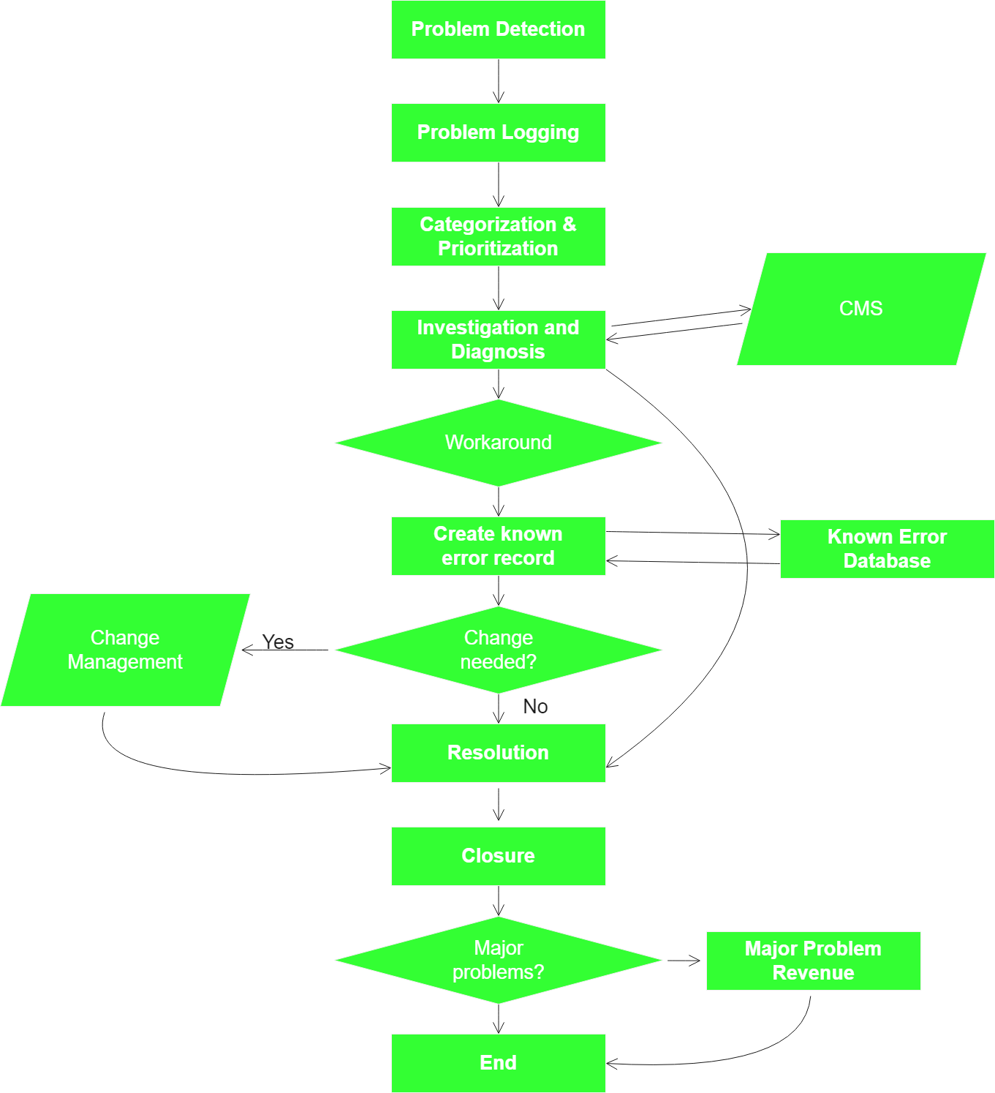
1. Principles of Problem Management
Scope of Problem Management:
Problem detection
Problem logging
Problem categorization
Problem Prioritization
Problem investigation and diagnosis
Create a known error record
Problem resolution and closure
Major problem review
Problem Management Workflow:

Slide 6
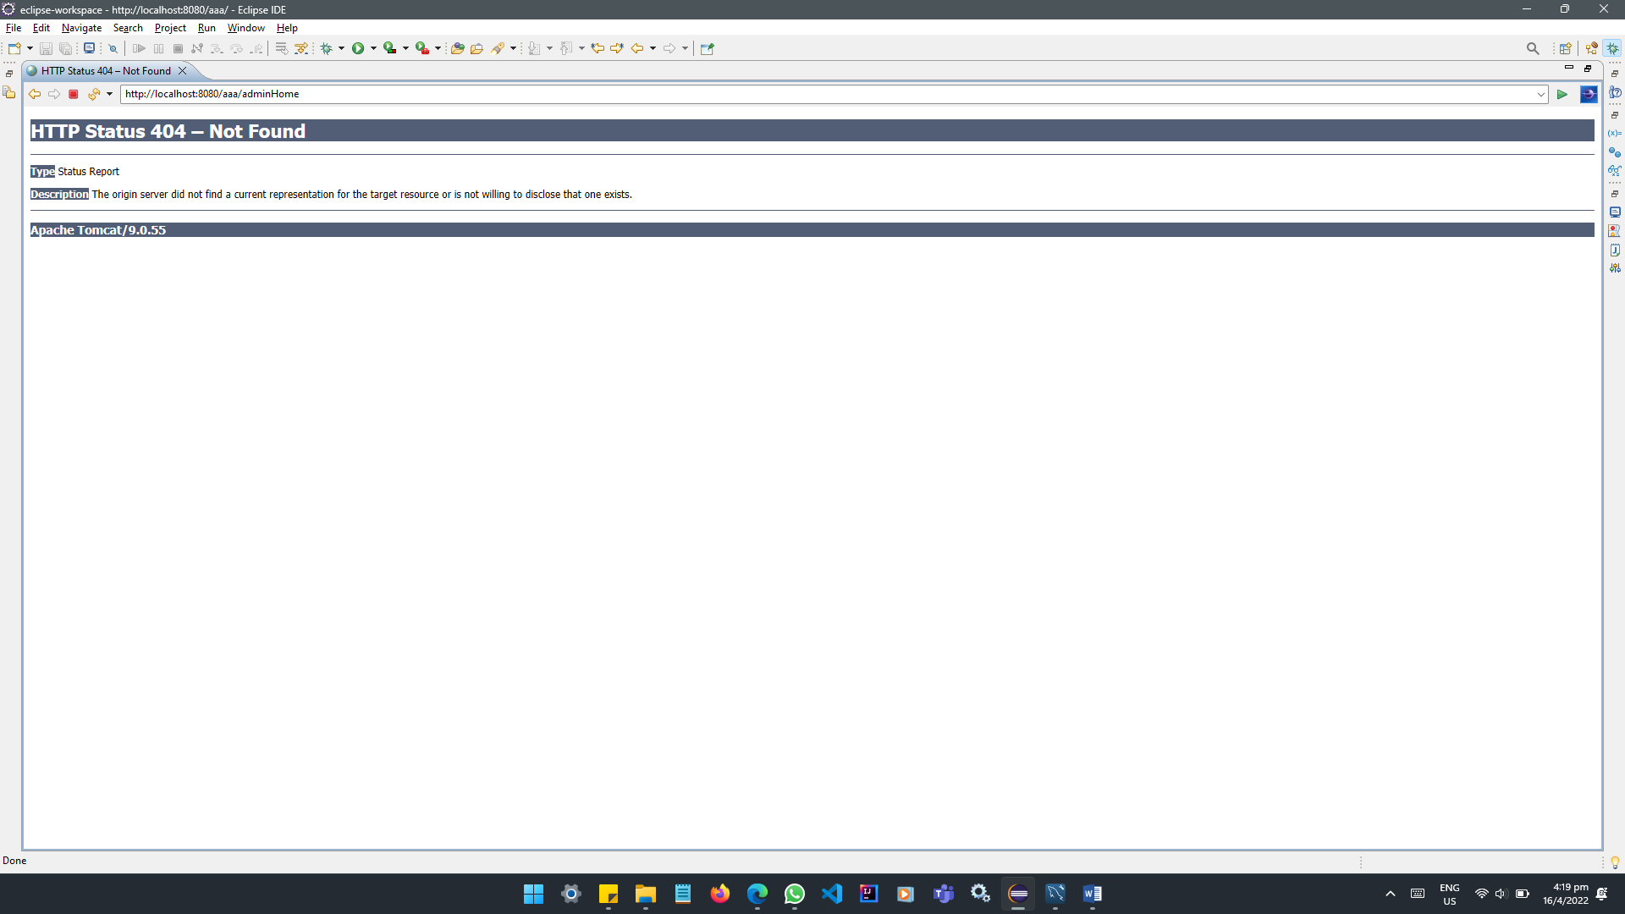
2. Problem Management Example
Problem Example: HTTP STATUS 404 – Not Found (Reactive)

Slide 7
2. Problem Management Example
Problem Example: HTTP STATUS 404 – Not Found (Reactive)
Steps:
1. Problem Identification
Problem identified and reported as follow:
Error occurs when “Next” button is clicked.
Log the problem
3. Problem investigation and diagnosis
Identified that the missing mapping in relation to the button appearing on list.jsp line no.56.
<a href=”next”>Next</a>
There is no matching mapping for “/next” in any controllers.
4. Problem resolution and closure
Added mapping for “/next” in line 38 in ExampleController.java
@GetMapping(”/next”)
public String next() {
return “next”;
}
Case No. | Date | Time | Problem | Error Msg/Code | Attachment
E01 | 10/05/22 | 10:00 | Unable to proceed after clicking “Next” button from the following url: http://8080.aaa/list.jsp | 404 – Not Found | Nil
Case No. | Date | Time | Problem | Error Msg/Code | Attachment | Status
E01 | 10/05/22 | 10:00 | Unable to proceed after clicking “Next” button from the following url: http://8080.aaa/list.jsp | 404 – Not Found | Nil | Problem Fixed. Case closed

Slide 8
3. Tools, Process & Technologies
Problem Management Process
1. Detect the Problem (Proactive/ Reactive)
A problem can be proactive or reactive. Proactive is often an evaluation of incident patterns or continual service improvement processes.
Both proactive and reactive leads to logging a problem ticket/escalated to relevant department.
2. Log the problem
Logging of problem should include details like time and date of occurrence, related incident(s), symptoms, the previous troubleshooting steps and the problem category.
3. Categorize the problem
Categorizing the problem allows the service desk to sort and model incidents that occur regularly, automatic assignment of prioritization and the ability to gather and report on service desk data.
Problems are prioritized based on how a problem impact the business. Prioritizing the problem allows an organization to utilize investigative resources effectively. High priority problem usually means that there is an urgency to address the issue.
4. Problem Analysis
Problem analysis involves investigation of the possible causes. High-priority issues should always be addressed first. While a problem can take from an hour to months to resolved, a workaround should always be indicated. Workarounds are temporary measures that help to enable the service desk to restore services to users.
5. Problem Solutions
Problems should be resolved whenever possible. Resolution resolves the underlying causes and prevents recurrences.
6. Close the problem
Closing the problem only occur after the problem has been raised, categorized, prioritized, identified, diagnosed and resolved. Many organizations stop at this step. However, reviewing the problem should follow after closing the problem.

Slide 9
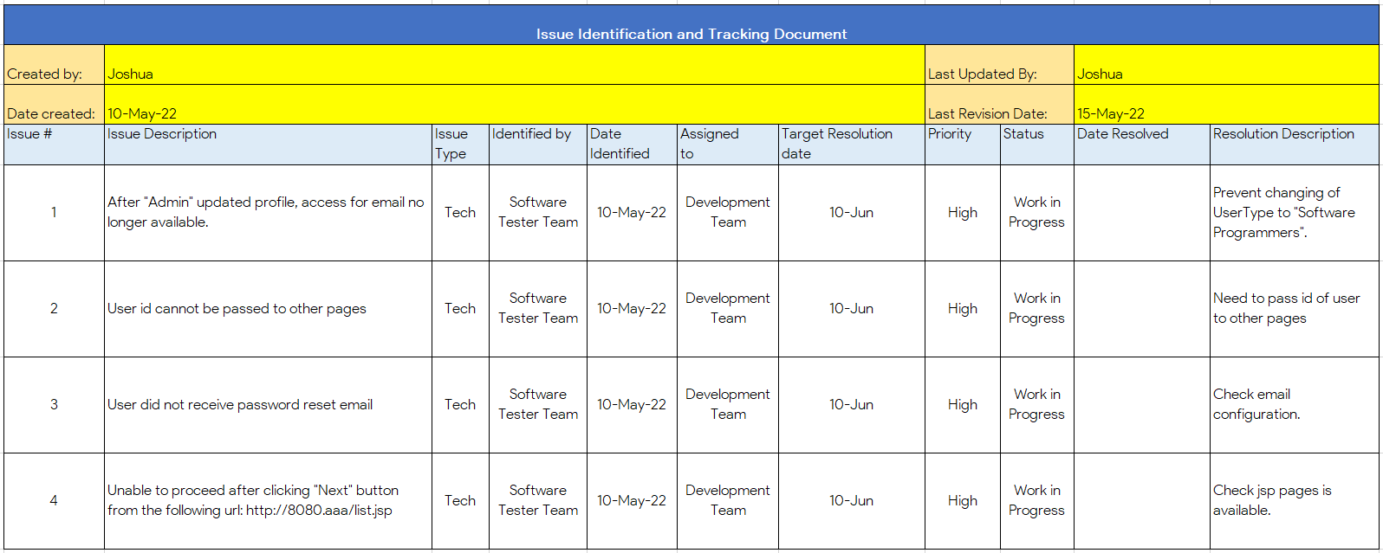
3. Tools, Process & Technologies
Problem Management Tools
1. Issue Identification and Tracking Document
2. Known Error Database (KEDB)
3. HP OpenView ServiceCenter

Slide 10
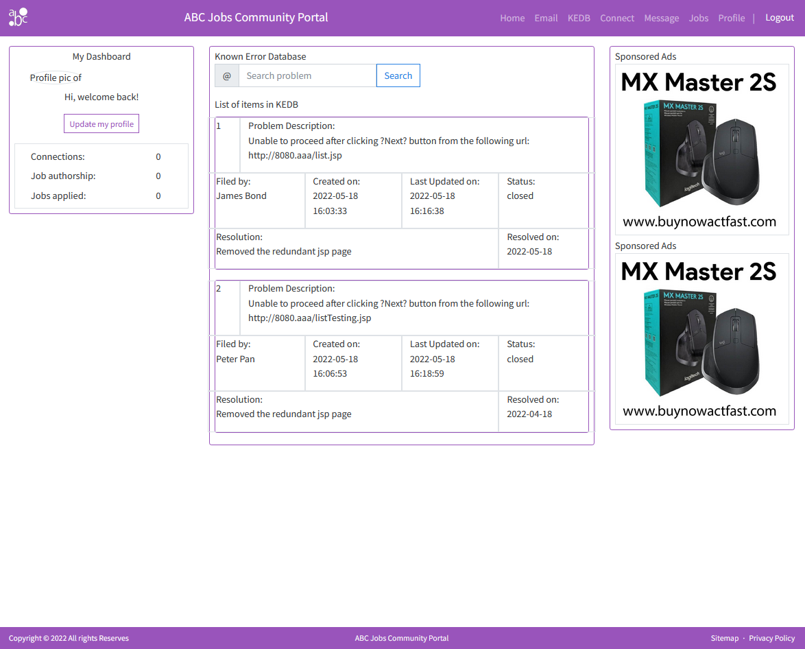
3. Tools, Process & Technologies
Problem Management Tools
2. Known Error Database (KEDB)
3. HP OpenView ServiceCenter

Slide 11
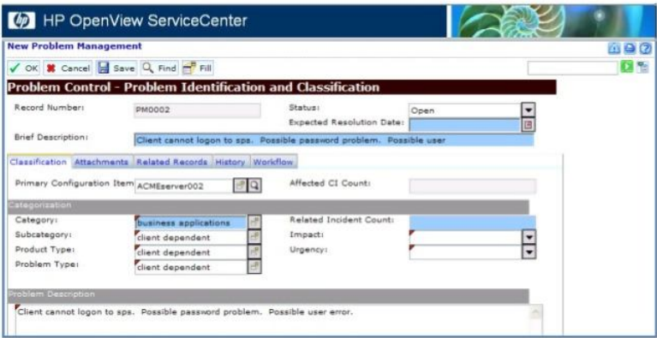
3. Tools, Process & Technologies
Problem Management Tools
3. HP OpenView ServiceCenter

Slide 12
3. Tools, Process & Technologies
Problem Management Tools
1. Issue Identification and Tracking Document
2. Known Error Database (KEDB)
3. HP OpenView ServiceCenter

Slide 13
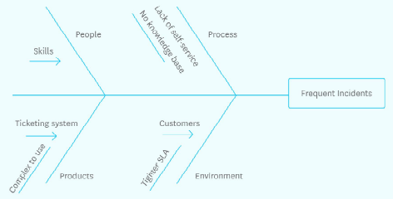
4. Investigation & Diagnosis
Steps of Fish bone RCA:
1. Define problem statement
A problem statement is a description of an issue that requires urgent attention. Explains why the problem matters and what would happen to the project if the issue is not fixed on time. It helps team leaders to understand the current issues affecting the project and build on that to find practical solutions.
2. Add cause categories as fish bones

Slide 14
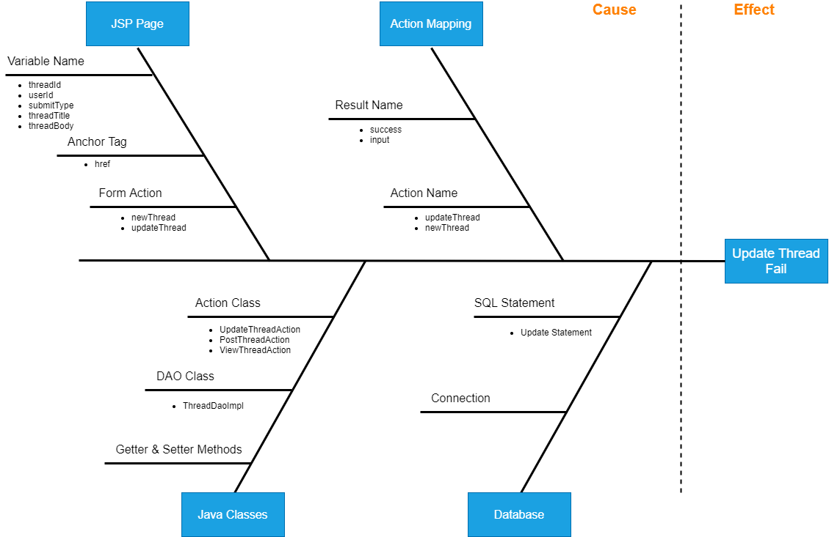
4. Investigation & Diagnosis
3. Use traditional brainstorming techniques to fill in possible reasons
Problems with Database possible causes:
Connection – JDBC, DB Server, and etc.
SQL Statement – Repositories, outdated queries, and etc.
4. Classify and prioritizing primary and secondary causes as trunks

Slide 15
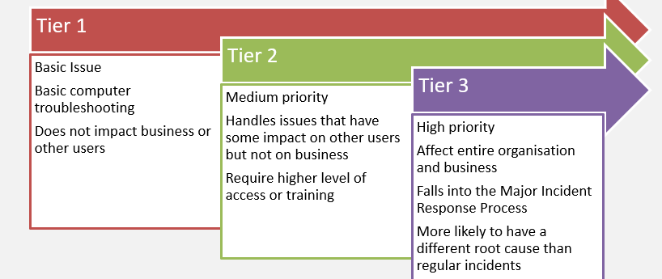
5. Explain Prioritization
Handling Tier | Tier 1 | Tier 2 | Tier 3
Priority | Low | Medium | High
Impact (Generally) | user | other users | business and other users
Description | Basic Issues that can be fixed with general computer troubleshooting and does not impact business or other users. | Issues that have some impact on the user but not on the business as a whole, medium priority that requires more immediate response and higher level of access or training than tier-one incidents. | High priority incidents that affect the entire organization and many users. Often, these incidents fall into Major Incident Response (MIR) process.

Slide 16
5. Explain Prioritization
Handling Tier | Tier 1 | Tier 2 | Tier 3
Priority | Low | Medium | High
Impact (Generally) | user | other users | business and other users
Description | Basic Issues that can be fixed with general computer troubleshooting and does not impact business or other users. | Issues that have some impact on the user but not on the business as a whole, medium priority that requires more immediate response and higher level of access or training than tier-one incidents. | High priority incidents that affect the entire organization and many users. Often, these incidents fall into Major Incident Response (MIR) process.
Categorize the problem
Categorizing the problem allows the service desk to sort and model incidents that occur regularly, automatic assignment of prioritization and the ability to gather and report on service desk data.
Problems are prioritized based on how a problem impact the business. Prioritizing the problem allows an organization to utilize investigative resources effectively. High priority problem usually means that there is an urgency to address the issue.

Slide 17
6. Problem Management Solution
One of the solutions to implement a Problem Management Process in the operations of the organisation.. This Problem management process consist of both reactive and proactive Problem Management.
Proactive Problem Management identify and solve Problems befoe any incidents have occurred. This activity is associated with Continual Service Improvement(CSI).
Have a Known Error Database where workarounds are recorded. Having a KEDB is also essential for Incident Management.
The output of the problem management process would be a request for change, which would then be evaluated by the change management process

Slide 18
6. Problem Management Solution
Problem Example: HTTP STATUS 404 – Not Found (Reactive)
Steps:
1. Problem Identification
Problem identified and reported as follow:
Error occurs when “Next” button is clicked.
Log the problem
3. Problem investigation and diagnosis
Identified that the missing mapping in relation to the button appearing on list.jsp line no.56.
<a href=”next”>Next</a>
There is no matching mapping for “/next” in any controllers.
4. Problem resolution and closure
Added mapping for “/next” in line 38 in ExampleController.java
@GetMapping(”/next”)
public String next() {
return “next”;
}
Case No. | Date | Time | Problem | Error Msg/Code | Attachment
E01 | 10/05/22 | 10:00 | Unable to proceed after clicking “Next” button from the following url: http://8080.aaa/list.jsp | 404 – Not Found | Nil
Case No. | Date | Time | Problem | Error Msg/Code | Attachment | Resolution | Status
E01 | 10/05/22 | 10:00 | Unable to proceed after clicking “Next” button from the following url: http://8080.aaa/list.jsp | 404 – Not Found | Nil | Removed redundant links to prevent not found error. | Problem Fixed. Case closed

Slide 19
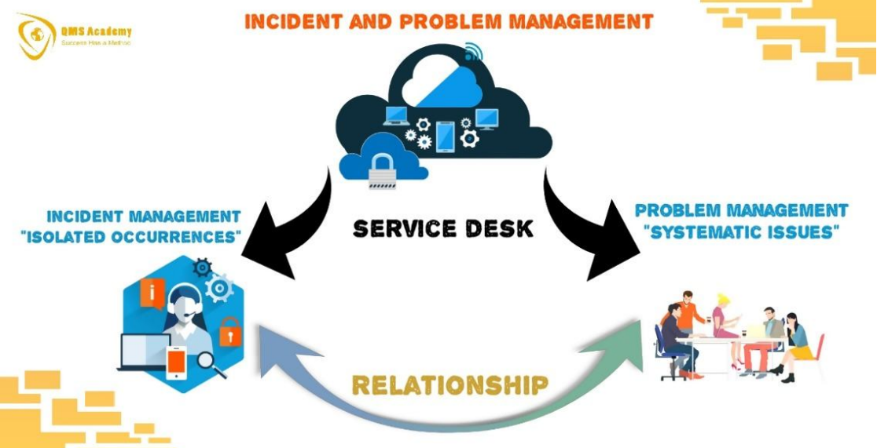
7. Systems you will Implement
Problem management eliminates the cause of failed services with the following steps:
1. Diagnose the problem and validate any workarounds.
2. Once identified, record as a “known error” in KEDB
3. Initiate a change request to be evaluated by the change management process.

Slide 20
7. Systems you will Implement
Problem management eliminates the cause of failed services with the following steps:
1. Diagnose the problem and validate any workarounds.
2. Once identified, record as a “known error” in KEDB
3. Initiate a change request to be evaluated by the change management process.
Proactive Problem management deals with identifying and solving problems before any incidents have occurred. This activity is associated with Continual Service Improvement (CSI).
Implement Problem management with planning in tools, system and training.
1. System and tools: Known Error Database as a tool for the Service Desk
2. Training: Problem Identification, Investigation, Analysis, Resolve and Review
Implement a Known Error Database into the Web Application for “Admin” users. The purpose of this database is to record known issues and workarounds. As the first interaction of the problem is at the Service Desk, having access to KEDB makes it easier to do Problem Controls and Error Controls.

Slide 21
8. Project Milestones & Tasks
Project Task ID | Project Task Description | Project Milestone ID
1 | Problem Detection | 1
2 | Log the problem | 1
3 | Categorize the problem | 1
5 | Problem Solutions | 2
6 | Close the problem | 3

Slide 22
9. Milestone Feedback & Action taken
Project Milestone ID | Milestone Feedback received from Tutor / Learning Facilitator | Action Taken (Yes / No)
1
2
3

Slide 23
10. Modifications Made based On Feedback

Slide 24
11. Project Results

Slide 25
11. Project Results

Slide 26
12. Proposed Improvements
List of Improvements
<List areas of improvement which you have identified after completion of the project>
……
……
……
……
……
……

Slide 27
13. Best Practises & Industry Standards
Information Technology Infrastructure Library (ITIL), is a set of detailed practices for IT activities. Here are the three of the practices/approaches from the ITIL 4 which may a workplace may adopt as best practice.
1. The 7 ITIL Guiding Principles
Focus on value
Start where you are
Progress iteratively with feedback
Collaborate and promote visibility
Thank and work holistically
Keep it simple and practical
Optimize and automate
This principle focuses primarily on simplicity and the prevention of complications. Using the minimum number of steps to deliver the desired outcome and not over-processing. It is better to apply general or standardized processes in exception handling.

Slide 28
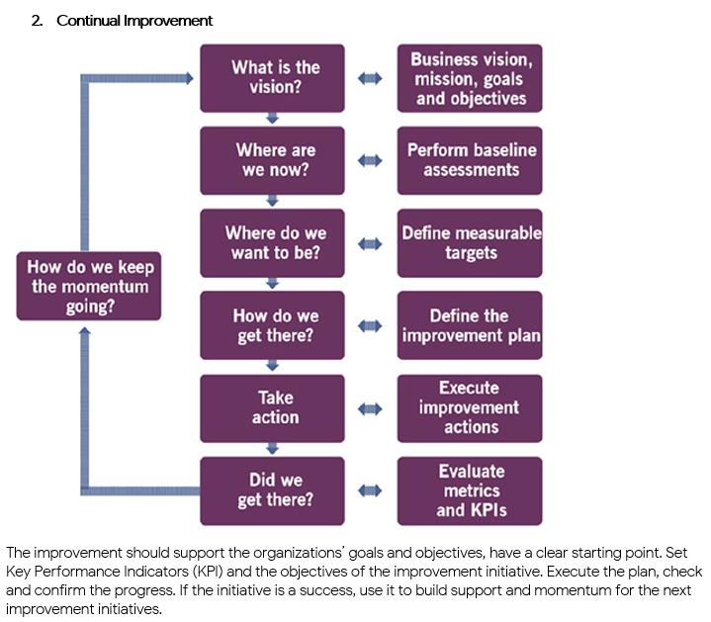
13. Best Practises & Industry Standards

Slide 29
13. Best Practises & Industry Standards
3. ITIL Service Value Chain
The ITIL SVC is an operating model that enables the delivery of services utilizing 6 key activities. These activities are:
Plan – Focuses on strategy, practitioners develop an understanding of what a service needs to deliver.
Improve – Gradual and continuous improvement of all activities.
Engage – Provide a service level by finding out what stakeholders needs are and guarantee complete transparency. These needs turn to become tangible design points.
Design and Transition – takes the expectations from previous state and make sure the service product satisfy it. Requirements are translated into Specifications.
Obtain/Build – Ensures service components meet required specs, effectively turns requirements into service components.
Deliver and Support – Focuses on deliverables of the services and products and Continual Service Improvement.
ITIL activities and practices are adopted in various ways in an organisation as best practices and/or industry standards.

